Slide 1
Introduction to Relational Database Administrator

Slide 2
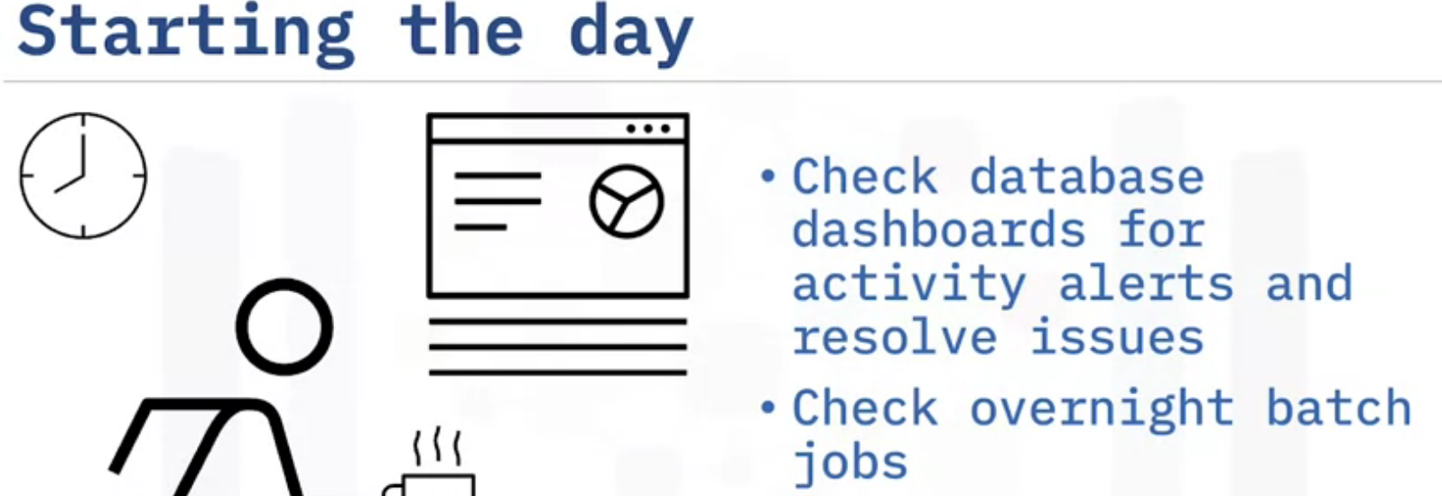
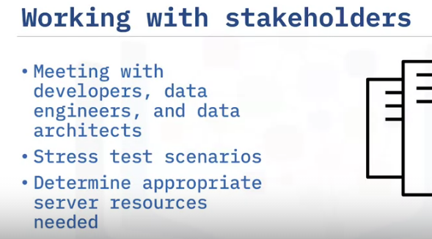
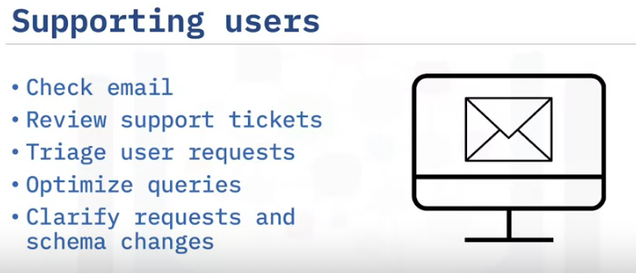
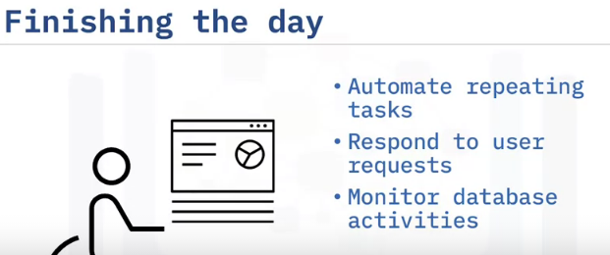
Kind of database workload simulation
Quick-check of database dashboard

Slide 3
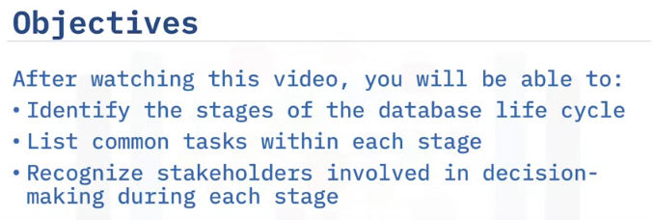
Database Management Lifecycle

Slide 4
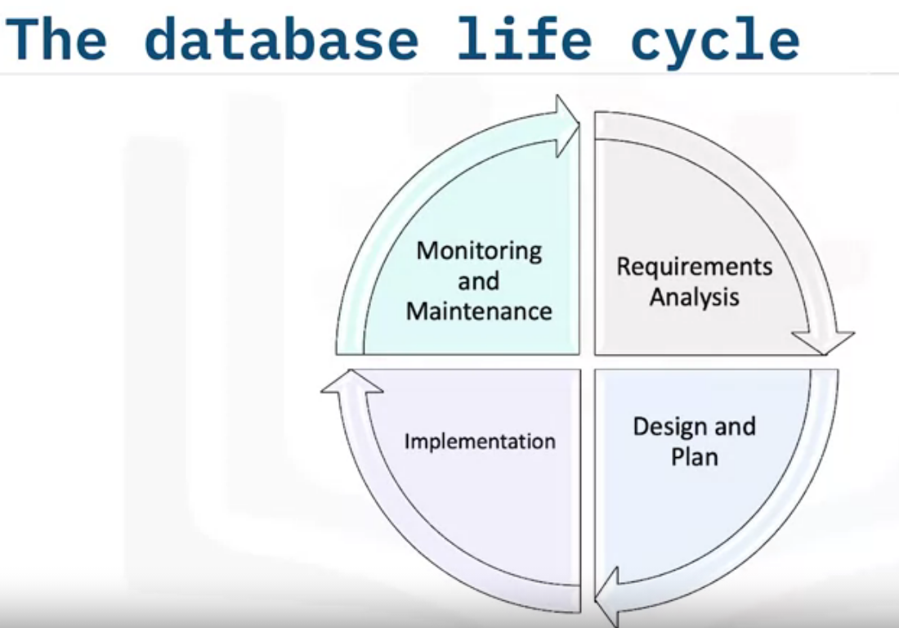
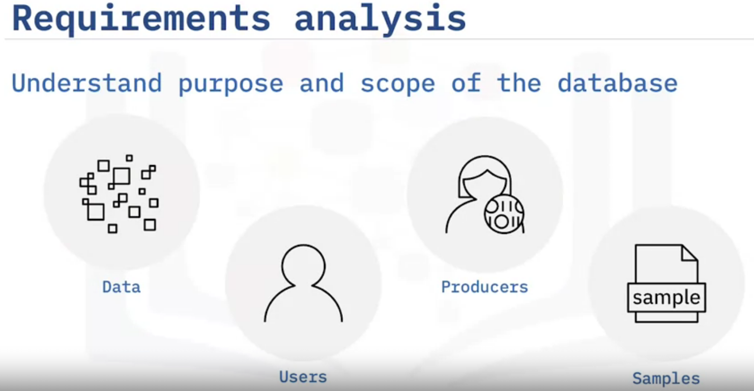
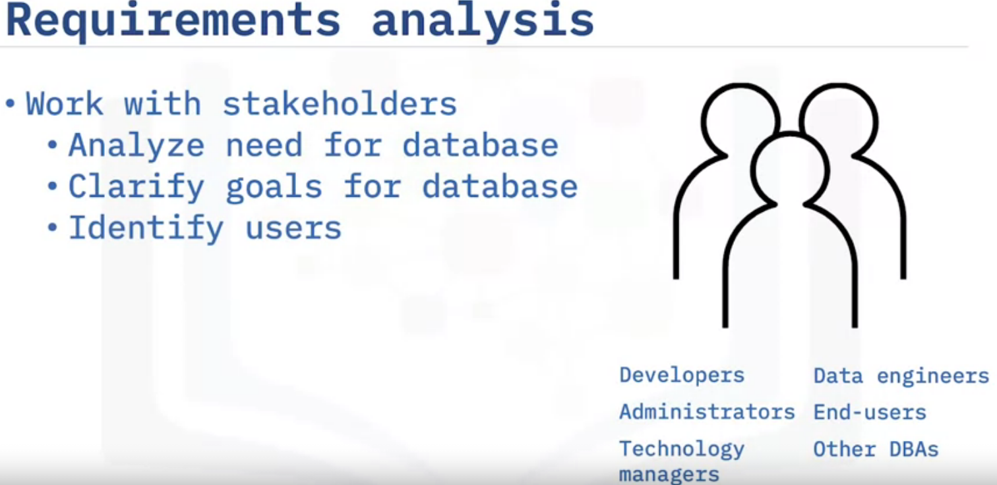

Slide 5
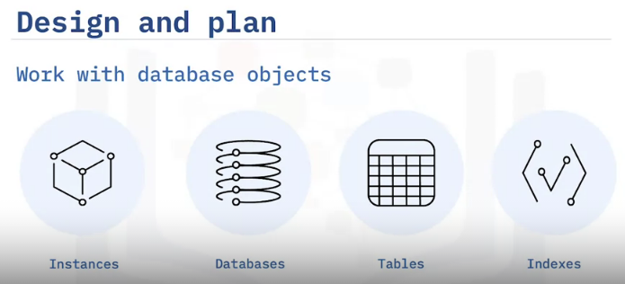
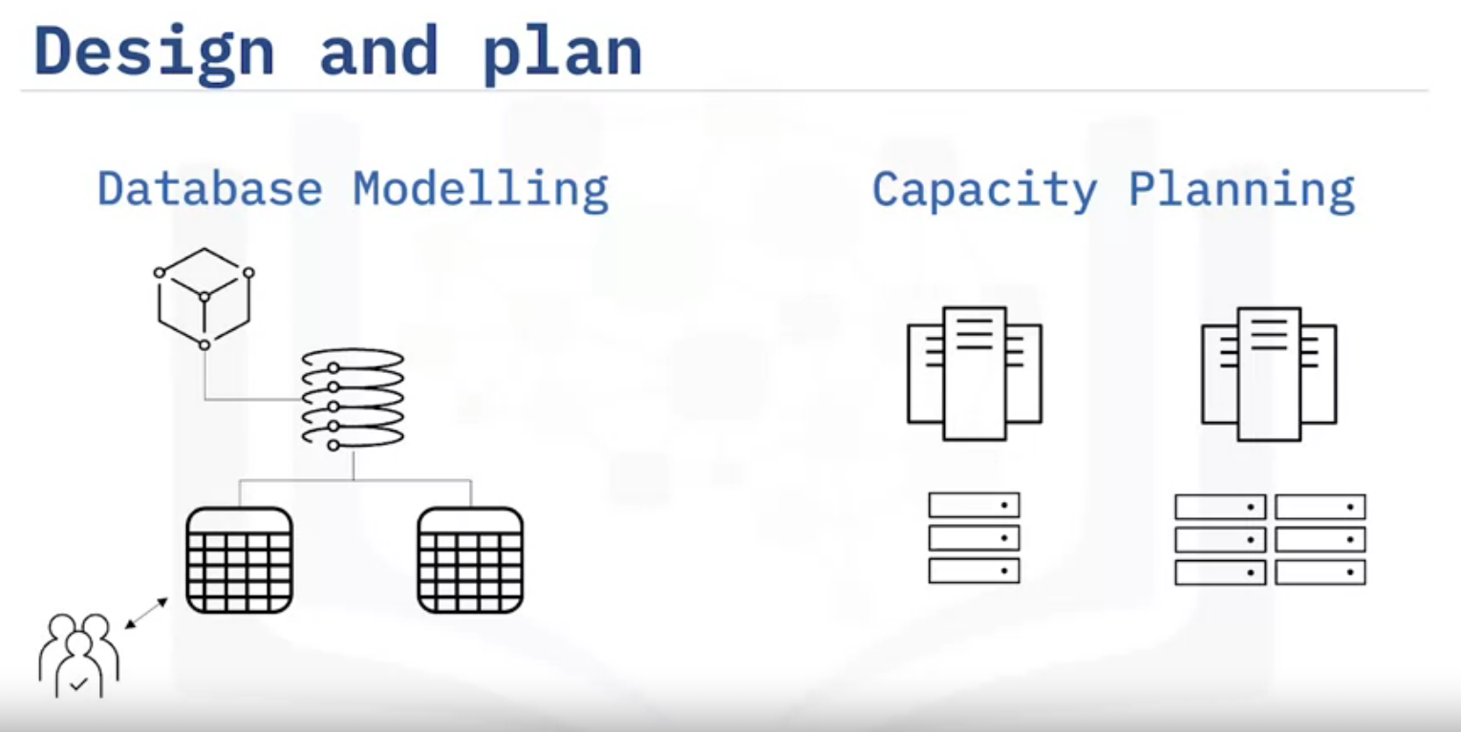
A database model represents the design of a database: which instance contains which databases and tables, how the tables relate to each other, how users access the data, and so on.
Database Architects and DBAs model the databases and their objects with the help of Entity Relationship Diagrams or ERDs.
In self-managed environments such as on-premise databases, DBAs also need to consider size, capacity, and growth.
They determine appropriate server resources like storage space, memory, processing power, and log file size.
They also need to plan for how database objects are physically stored.
For example, DBAs can choose to store frequently used data on a high-speed disk array or to store indexes separately from the data for better performance.

Slide 6
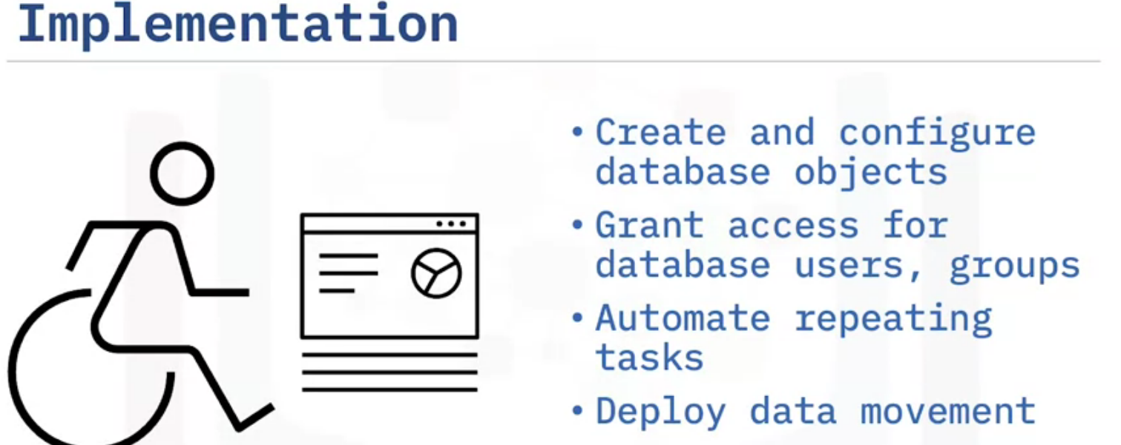
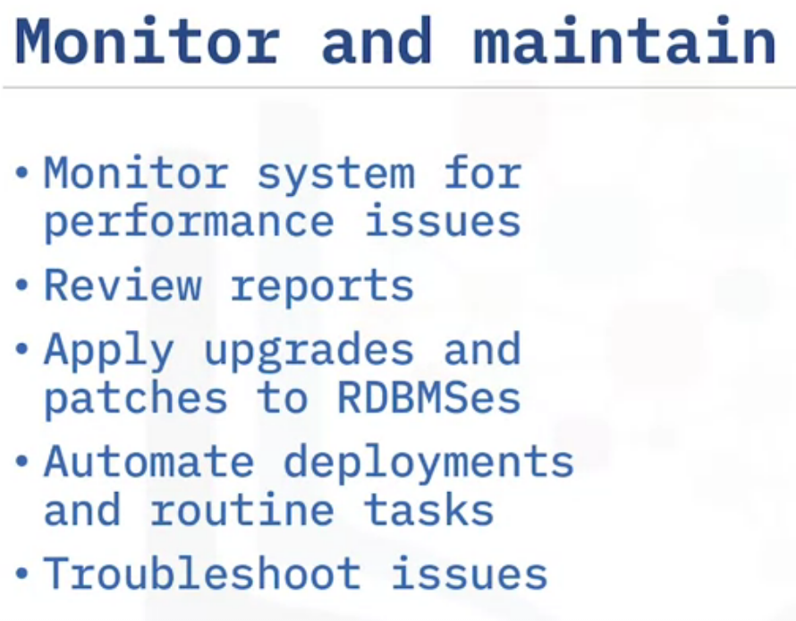
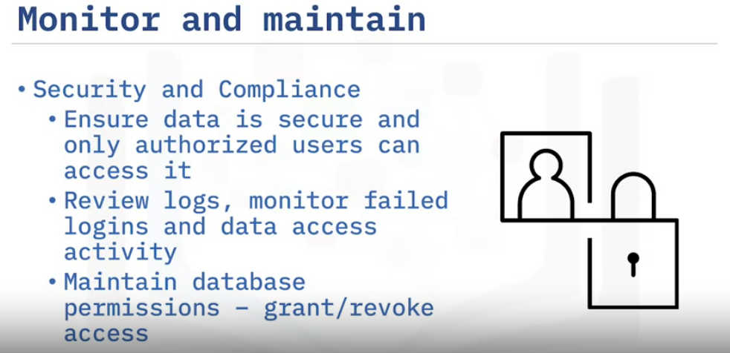

Slide 7
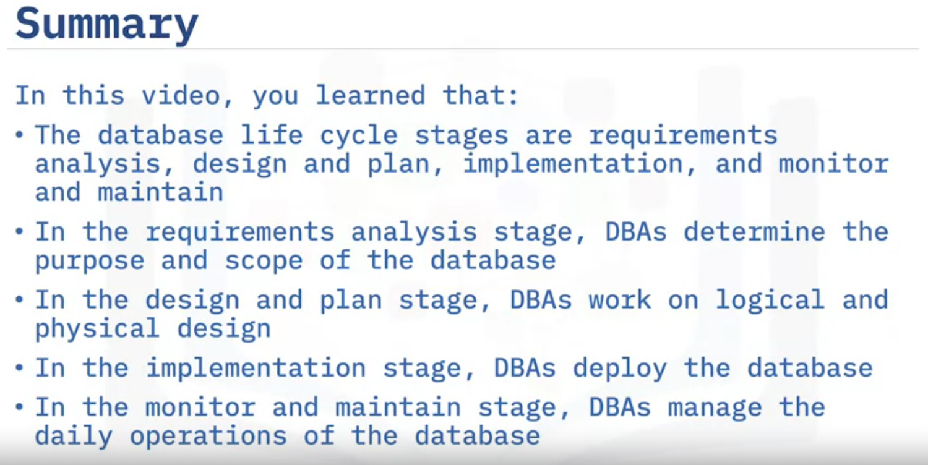

Slide 8
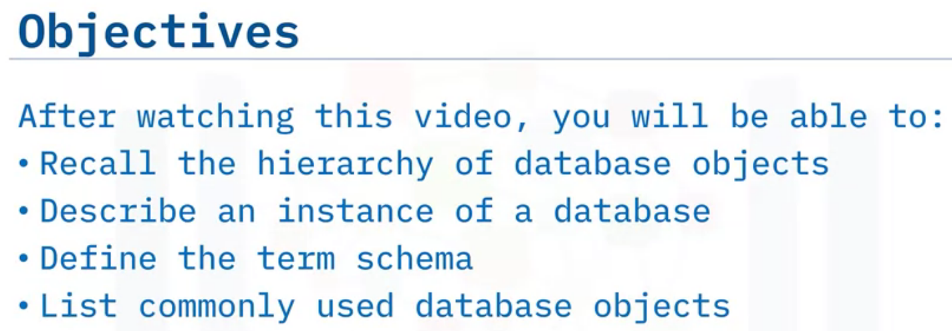
Server Objects & Hierarchy

Slide 9
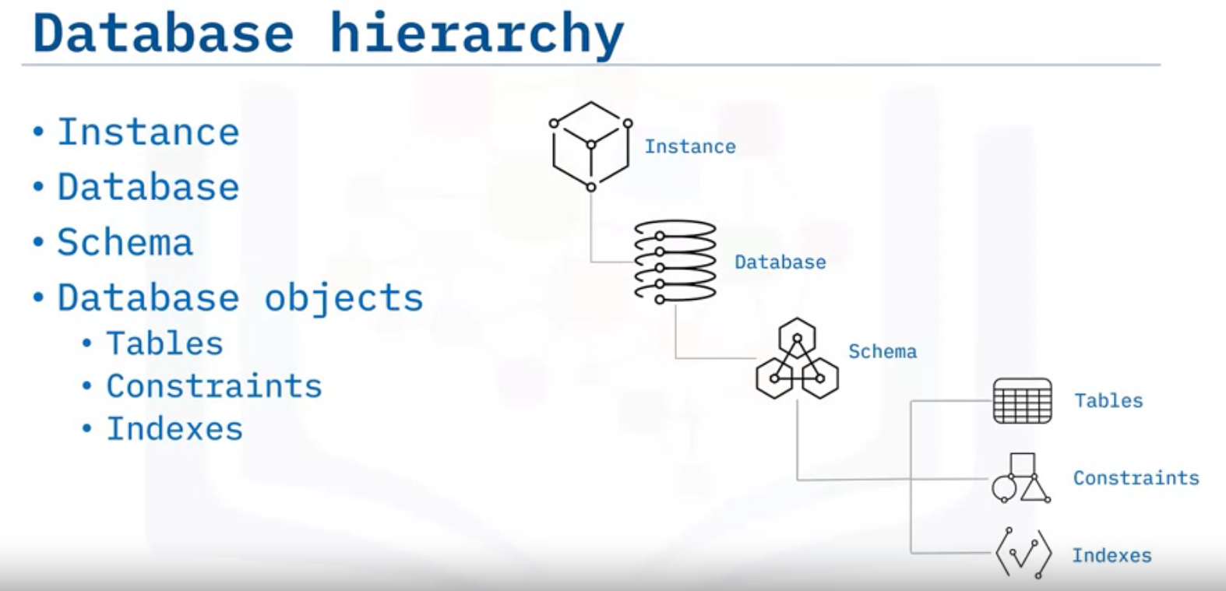

Slide 10
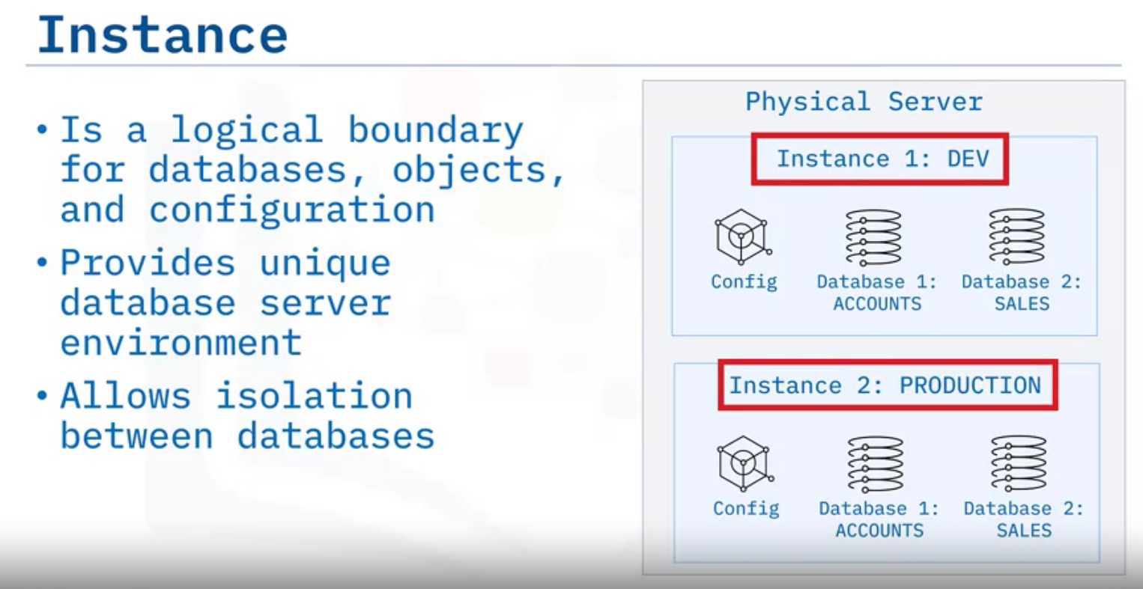
An instance is a logical boundary for a database or set of databases where you organize database objects and set configuration parameters.
Every database within an instance is assigned a unique name, has its own set of system catalog tables (which keep track of the objects within the database) and has its own configuration files.
You can create more than one instance on the same physical server, providing a unique database server environment for each instance.
The databases and other objects within one instance are isolated from those in any other instance.
You can use multiple instances when you want to use one instance for a development environment and another instance for a production environment, restrict access to sensitive information, or control high-level administrative access.
Not all RDBMSes use the concept of instances, often managing database configuration information in a special database instead.
In Cloud-based RDBMSes, the term instance means a specific running copy of a service.

Slide 11
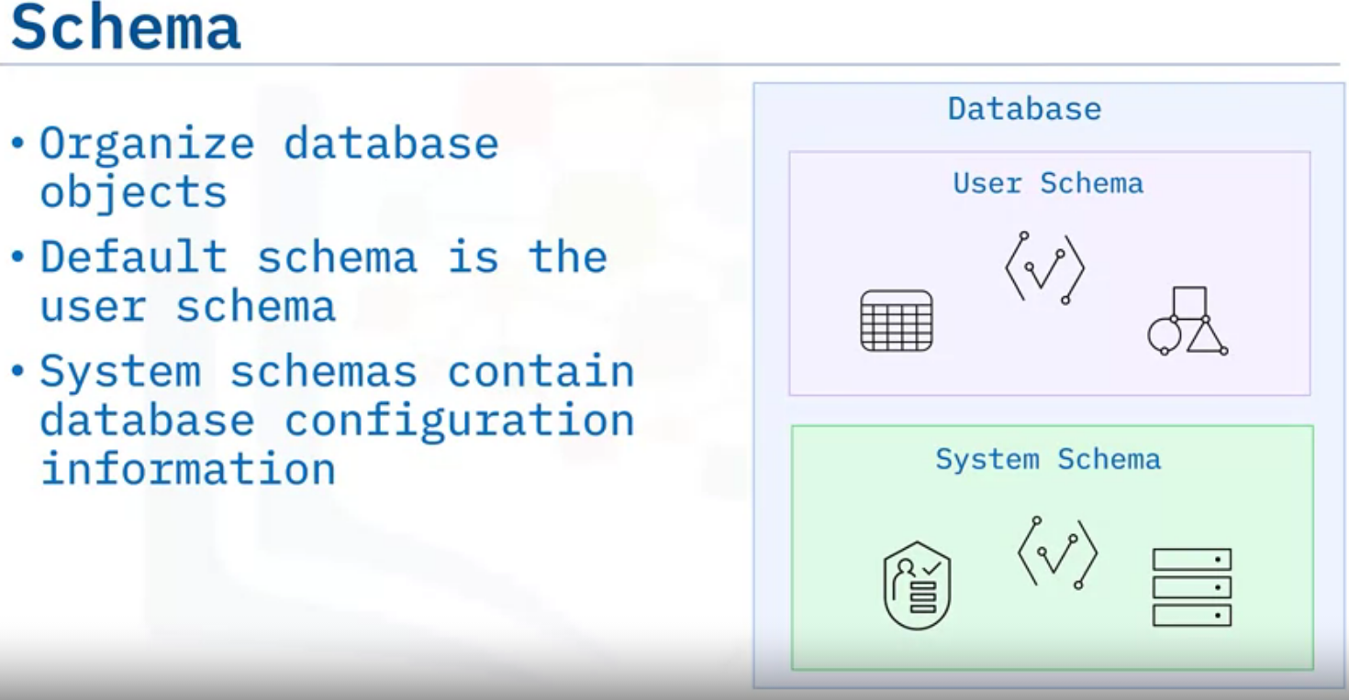
A schema is a specialized database object that provides a way to group other database objects logically.
A schema can contain tables, indexes, constraints, and other objects.
When you create a database object, you can assign it to a schema.
In most RDBMSes, the default schema is the user schema for the currently logged-on user.
Many RDBMSes use a specialized schema to hold configuration information and metadata about a particular database.
For example, tables in a system schema can store lists of database users and their access permissions, information about the indexes on tables, details of any database partitions that exist, and user-defined data types.

Slide 12
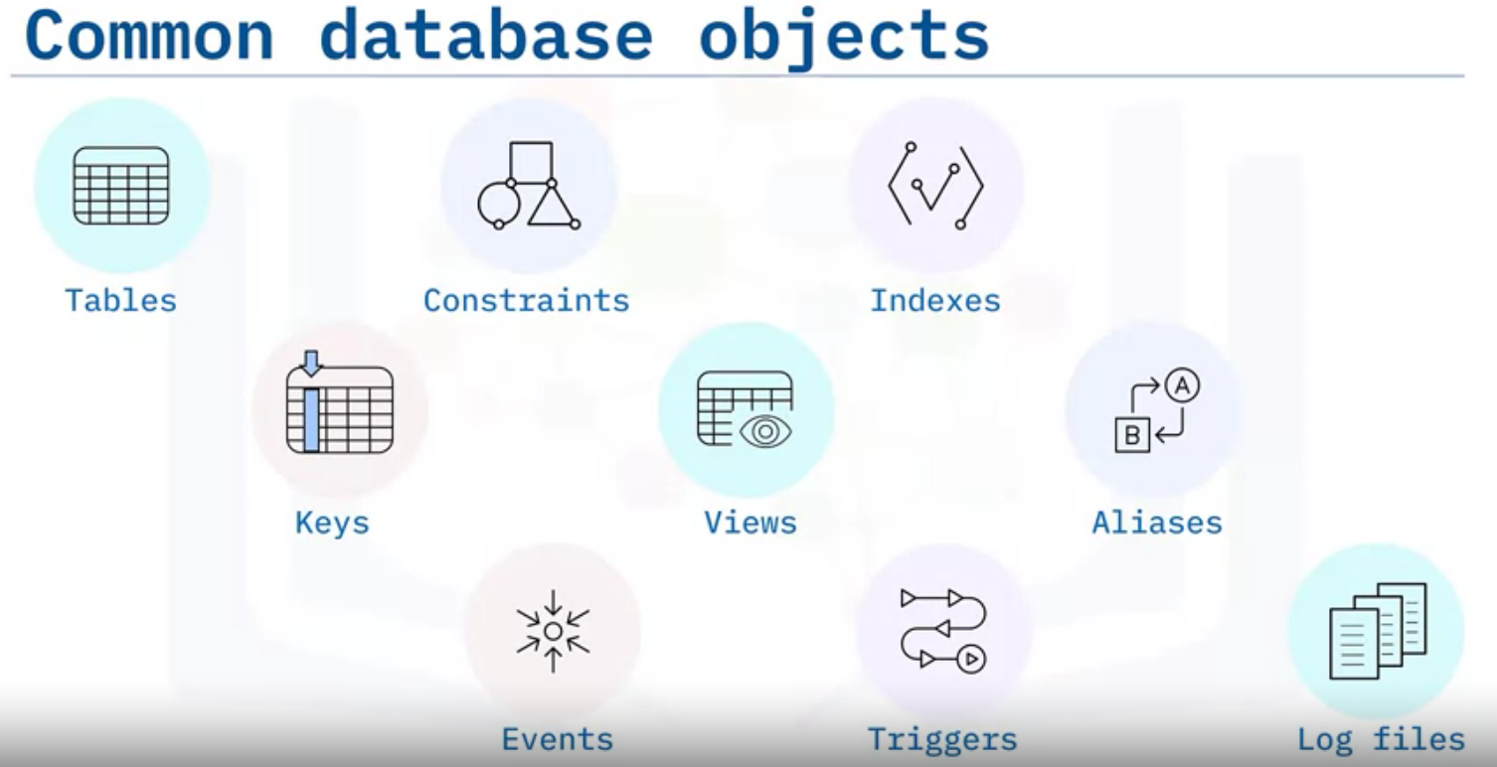
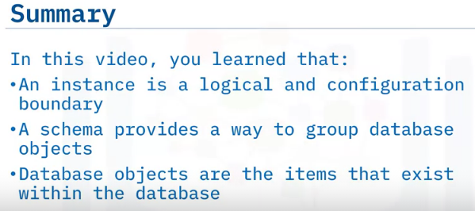
Database Objects
Database objects are the items that exist within the database.
The process of database design includes defining database objects and their relationships with each other.
You can create and manage database objects through graphical database management tools, scripting, or accessing the database through an API.

Slide 13
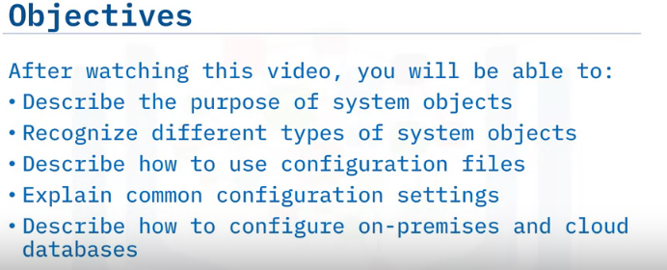
System Objects and Database Configuration

Slide 14
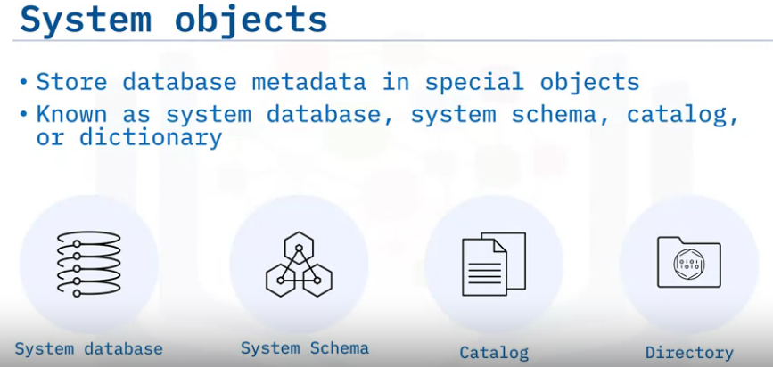
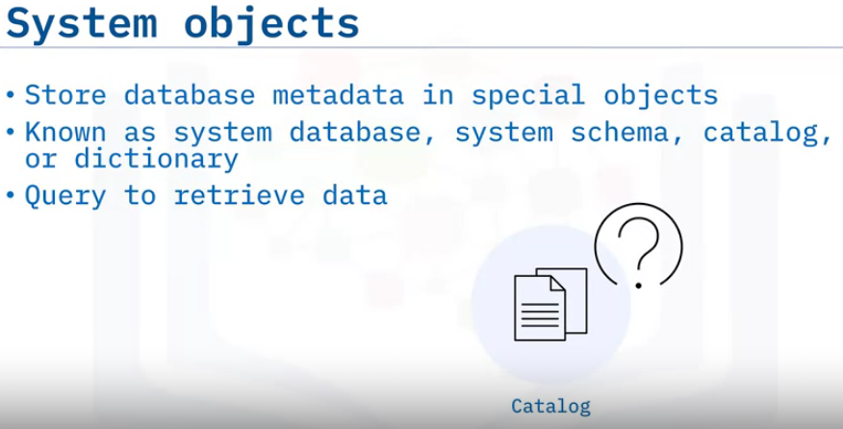
RDBMSes store information about their databases, known as metadata, in special databases, schemas, or catalogs.
They store specific types of information about the database, such as the name of a database or table, the data type of a column, or access privileges, known as metadata.
Other terms used for this information store are data dictionary and system catalog.
The RDBMS controls and updates the system objects, but you can query the metadata tables to discover information about the objects in the database.

Slide 15
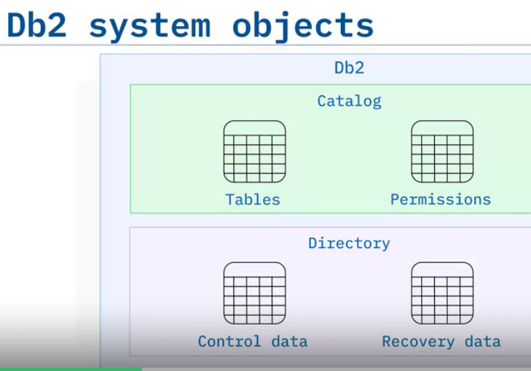
Different RDBMSes use different names for their metadata stores:
Db2 uses the catalog and the directory.
The catalog consists of tables of data about everything defined to the Db2 system.
When a user creates, alters, or drops any object, Db2 inserts, updates, or deletes rows of the catalog that describe that object and how it relates to other objects.
The directory contains the Db2 internal control data used by Db2 during its normal operation.
Among other things, the directory contains database descriptors, access paths for applications, and recovery and utility status information.

Slide 16
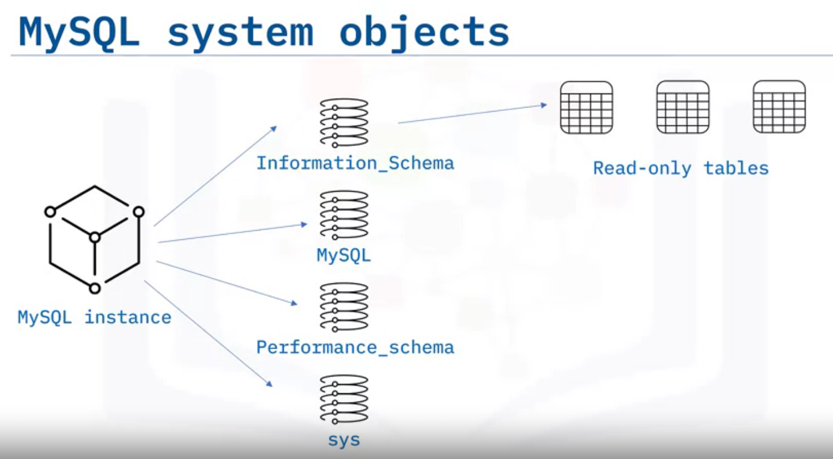
MySQL uses a system schema to store database metadata.
For example, each new MySQL instance has four system databases: information_schema, mysql, performance_schema, and sys.
Each system database contains several read-only tables.

Slide 17
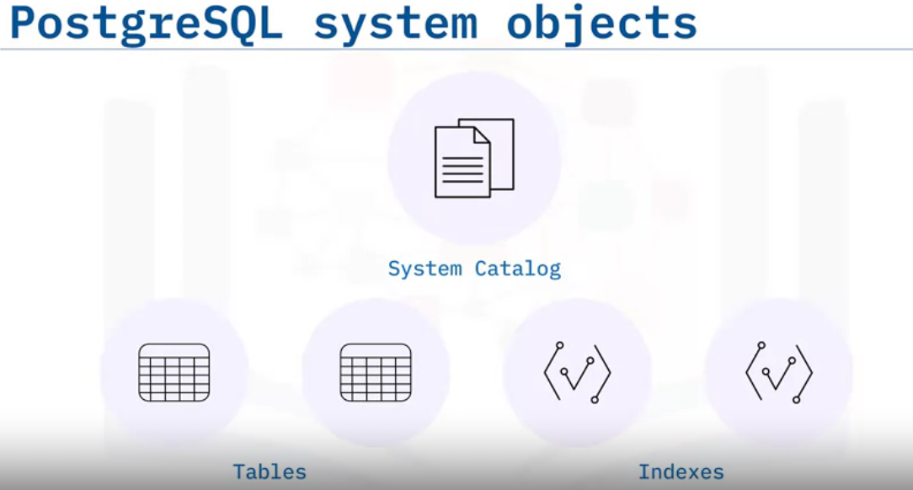
PostgreSQL uses the system catalog, which is a schema with tables and views that contain metadata about all the other objects inside the database, and more.
With it, you can discover when various operations happen, how tables or indexes are accessed, and whether the database system is reading information from memory or needing to fetch data from disk.

Slide 18
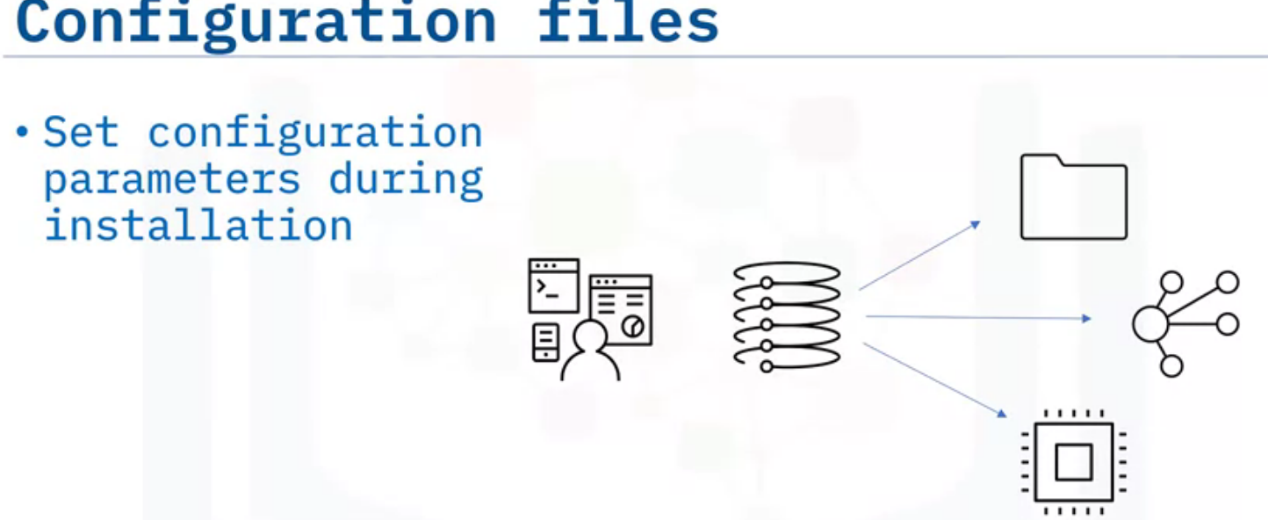
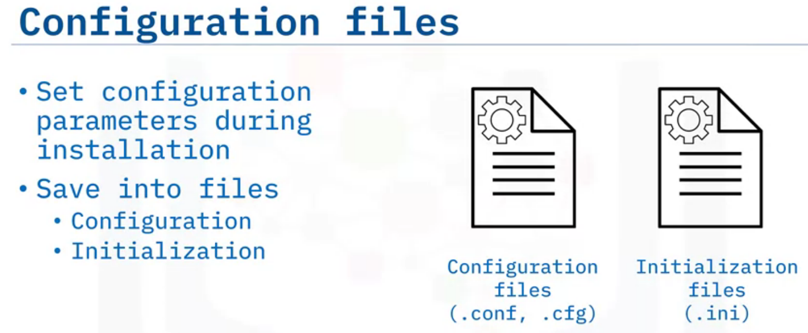
During any database installation, you supply parameters like the location of the data directory, the port number that the service listens on for connections, memory allocation, and much more.
You can accept the default options or supply custom values to suit the environment.
The database installation process saves this information into files, known as configuration or initialization files.
The database uses the information in these files to set parameters as it starts up.
Again, different RDBMSes use different files, file locations, and settings. Still, they all serve the same purpose: to provide the initial configuration information for the database as it starts up and operates.

Slide 19
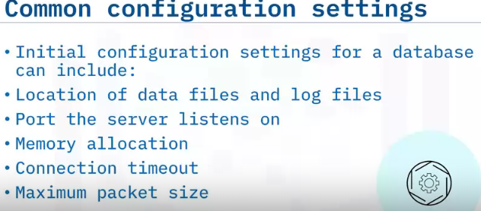
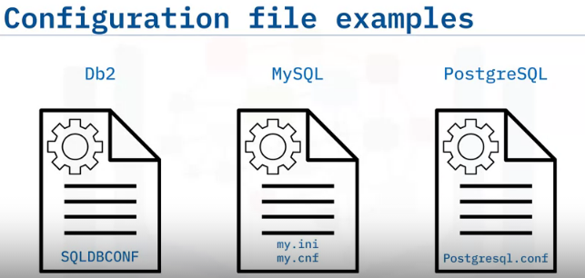
To store configuration information: Db2 uses the SQLDBCONF file.
MySQL uses my.ini files on Windows-based systems and my.cnf files on Linux-based systems.
PostgreSQL uses the postgresql.conf file.
Configuration information can include general settings like the location of data and log files, and the port the server listens on for requests.
Or configuration information can be more focused, like settings that affect performance, including memory allocation, a connection timeout, and the maximum packet size.

Slide 20
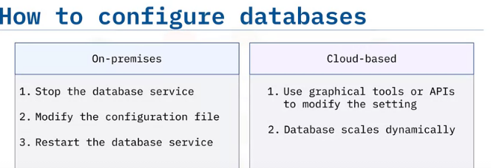
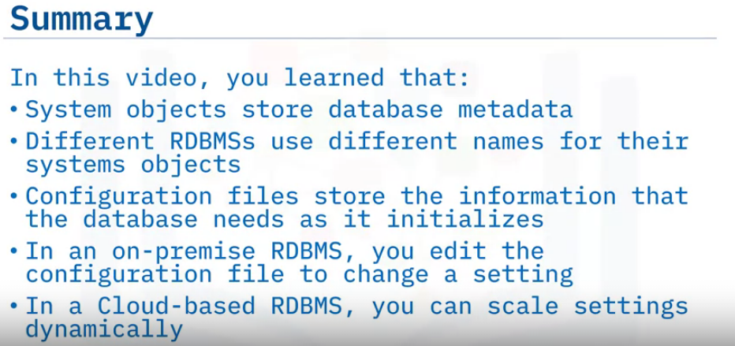

Slide 21
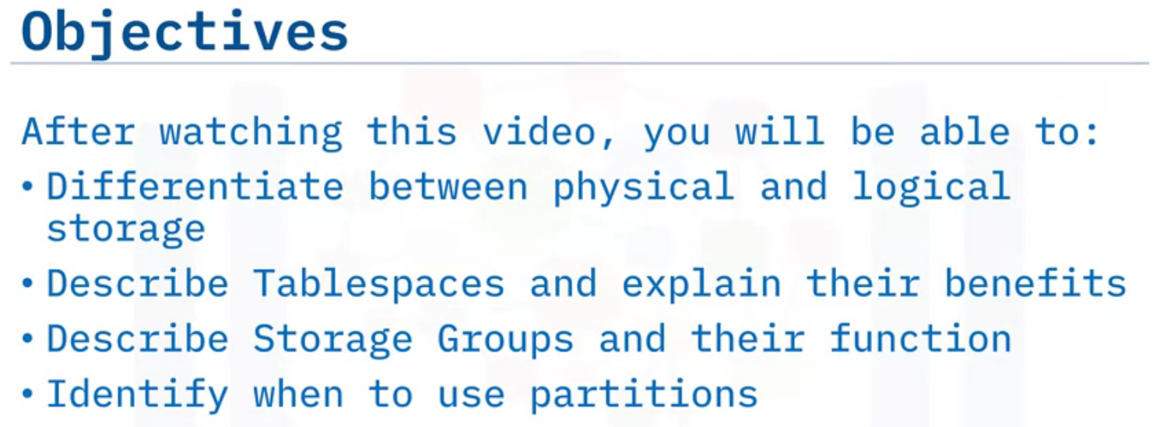
Database Storage

Slide 22
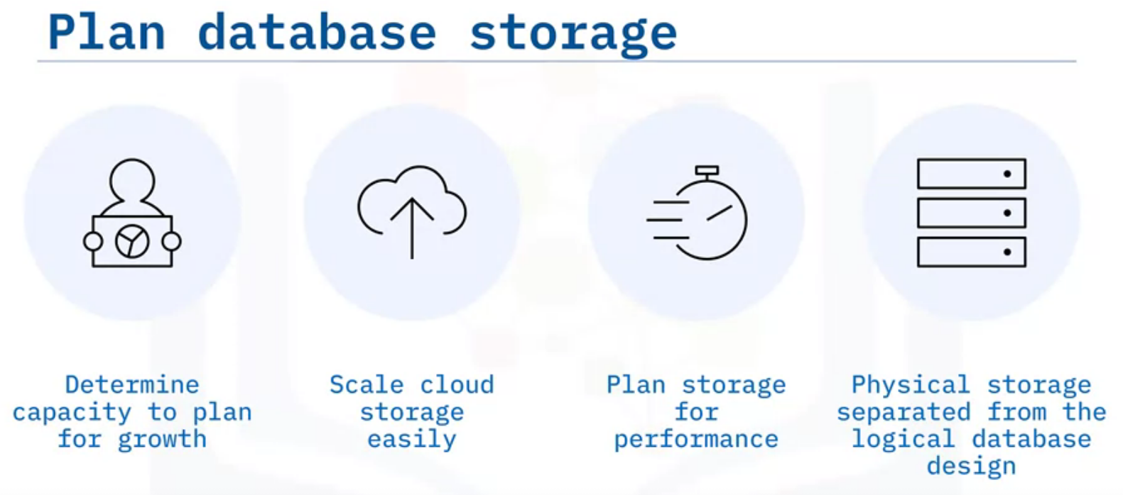
cloud
Self managed
As a DBA, you need to ensure that database has enough storage space for all the data it needs to store. You must determine the capacity required for the database and plan for growth.
In cloud-based databases expanding your storage space is performed through an API or a Graphical Console. One of the advantages of using a cloud-based database is that it is so easy to scale up and scale down in terms of storage space.
In a self-managed or on-premises environment, you can also plan storage space for improved performance, storing competing resources on different disks.
RDBMSes separate the physical storage of database files on disk from the logical design of the database, allowing more flexibility in managing the data files.
You can manage the data through a logical object without being concerned about the nature of the physical storage. For example, you can issue a command to back up a database without having to specify all the physical disks that store the database.

Slide 23
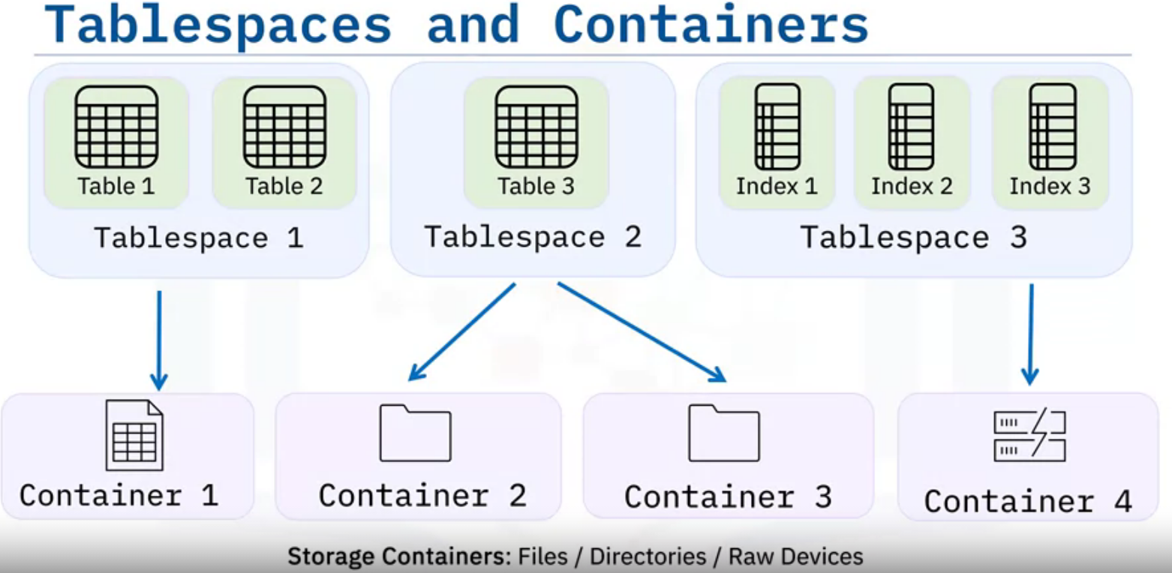
Tablespaces are structures that contain database objects such as tables, indexes, large objects, and long data.
DBAs use tablespaces to logically organize database objects based on where their data is stored.
Tablespaces define the mapping between logical database objects and the physical storage containers that house the data for these objects.
A storage container can be a data file, a directory, or a raw device.
Tablespaces can contain one or more database objects.
In this example, Tablespace 1 contains multiple small tables, whereas Tablespace 2 only houses a single large table. Tablespace 3 contains frequently used indexes.
DBAs configure one or more storage containers to store each tablespace.
In this example, Container 1 stores Tablespace 1, Containers 2 and 3 store Tablespace 2, and Container 4 stores Tablespace 4.

Slide 24
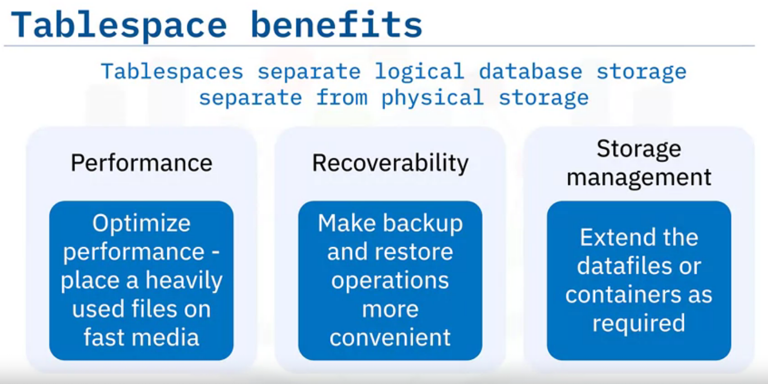
By using the combination of tablespaces and containers, you can keep logical database storage separate from physical storage and manage the disk layout of a database and its
objects.
This results in several benefits:
Performance: You can use tablespaces to optimize performance. For example, you can place a heavily used index on a fast SSD.
Alternatively, you can store tables containing rarely accessed or archived data on a less expensive but slower magnetic hard drive.
Recoverability: Tablespaces make backup and restore operations more convenient. Using a single command, you can make a backup or restore all the database objects without
worrying about which storage container each object or tablespace is stored on.
Storage Management: The RDBMS creates and extends the datafiles or containers depending on the need.
When necessary, you can also manually expand the storage space by adding another storage path or container to the tablespace.

Slide 25
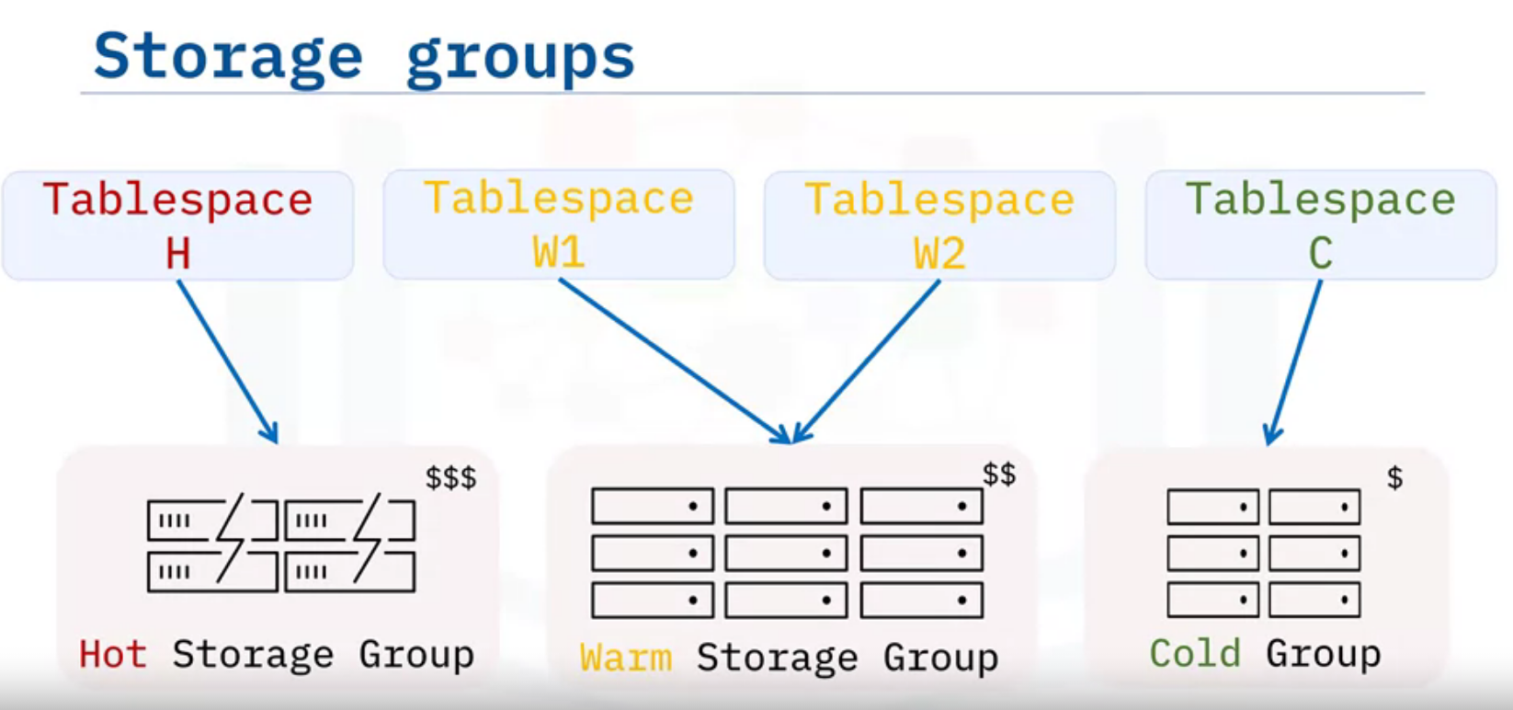
Some RDBMSes provide Storage Groups.
A storage group is a grouping of storage paths or containers based on similar performance characteristics.
This allows you to perform Multi-Temperature Data Management more easily. b
in this context, temperature refers to the frequency of data access.
Hot data is accessed very frequently, Warm data is accessed somewhat frequently, and Cold data is accessed infrequently.
By using storage groups, you can organize your data and storage based on temperature. in this example, very frequently accessed hot tables can be placed in Tablespace H, which is distributed on a group of fast storage devices.
Somewhat frequently accessed tables in Tablespaces W1 and W2 can be stored on a Warm Storage Group.
And the least frequently accessed tables in Tablespace C can be stored on slower and less expensive storage devices in a Cold Group.
Using storage groups helps with optimizing performance for frequently accessed data and reducing costs for storing infrequently accessed data.

Slide 26
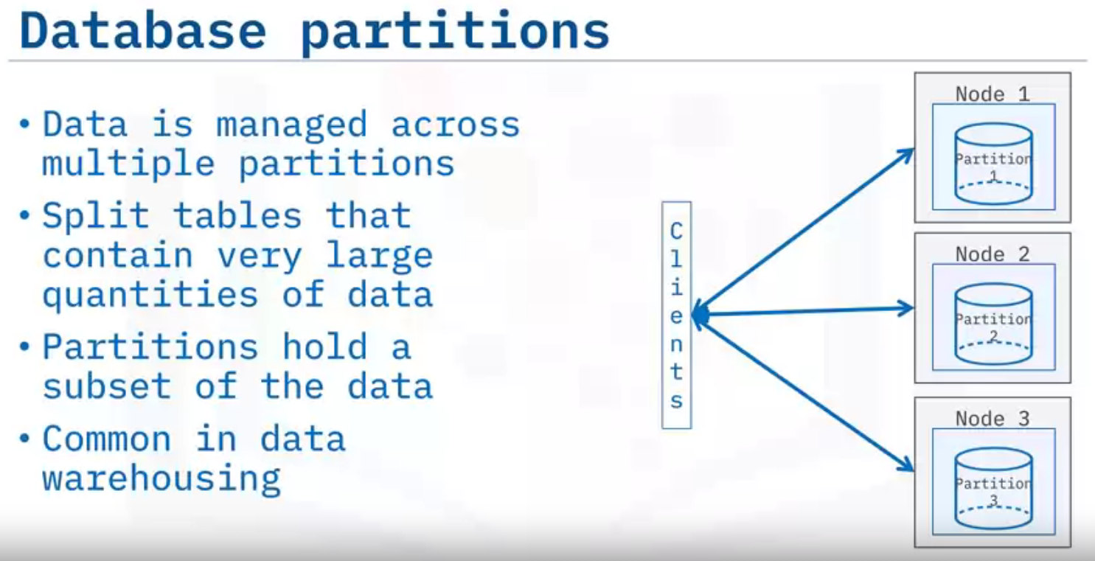
A partitioned relational database is a relational database whose data is managed across multiple database partitions.
You can partition tables that need to contain very large quantities of data into multiple logical partitions, with each partition containing a subset of the overall data.
Database partitioning is used in scenarios that involve very large volumes of data, such as data warehousing and data analysis for business intelligence.

Slide 27
